Slide 1

Predicting Used Car prices & Scrapping data
Submitted By :
PaNKAJ PAgare

Slide 2
CONTENT
Problem Description
Data pre-processing
EDA
Data cleaning
Model Deployment
Hyper Parameter Tuning
Conclusion

Slide 3
Problem Description & Understanding of Data

Slide 4
PROBLEM DESCRITION
With the covid 19 impact in the market, we have seen lot of changes in the car market. Now some cars are in demand hence making them costly and some are not in demand hence cheaper. One of our clients works with small traders, who sell used cars. With the change in market due to covid 19 impact, our client is facing problems with their previous car price valuation machine learning models. So, they are looking for new machine learning models from new data.
We have to make car price valuation model. This project contains two phase : -
Web Scrapping from websites
Model Building

Slide 5
COLUMN DISCRIPTION
Brand: Brand of Cars.
Model: Model of the car.
Auto_Manual : Car is Automatic or manual.
Variant: Type of car.
Mfg_year : Manufacturing year of Car.
Driven in_km : Car derived in kilometers.
Fuel : which type of fuel does the car used.
No_Of_Owner : No. of owners of the car.
Location : Location of the car from which city that car is used.
Price: Price i.e., the target variable in lacs in Indian rupee..

Slide 6
DATA SUMMERY:
Data has no null values
Data has 5484 no. of records that we scrapped and 10 no. of variables.
There were 6 object type variables, 3 integer type variable and the target variable is of float type.
Replace values in Brand columns such as HYUNDAI & RENAULT into Hyundai & Renault.
Removed such records whose value counts are less or that leads to underfitted for multiple columns.

Slide 7
Exploratory Data Analysis (EDA)

Slide 8
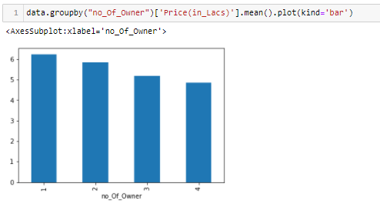
SHOWING AVERAGE PRICE FOR INDIVIUAL NO OF OWNERS
Less No Of User Their Car Price Are High.

Slide 9
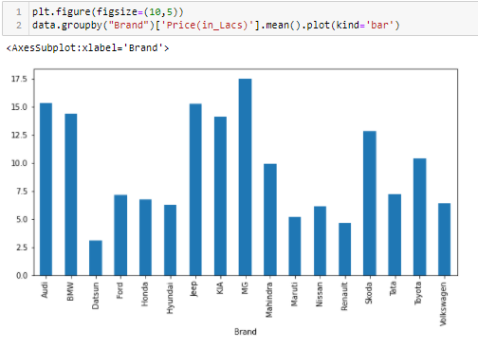
SHOWING AVERAGE PRICE FOR Brand of cars
Mercedes type Brand's car has the highest price.
Datsun type Brand's car has the lowest price.

Slide 10
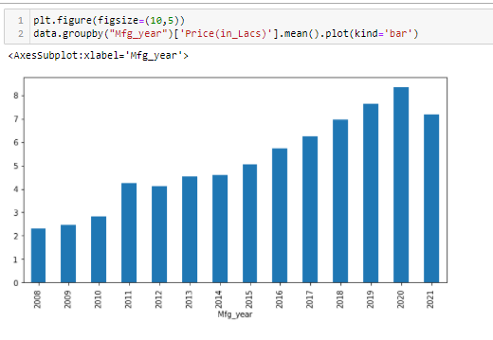
YEAR WISE AVERAGE SELLING PRICE OF THE CAR
As the year increases the price of car increasing.

Slide 11
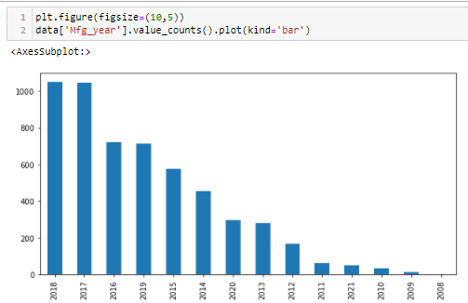
YEARS WISE NUMBER OF CARS SOLDS
The increased Demand of cars is highly in the year of 2017 and 2018.

Slide 12
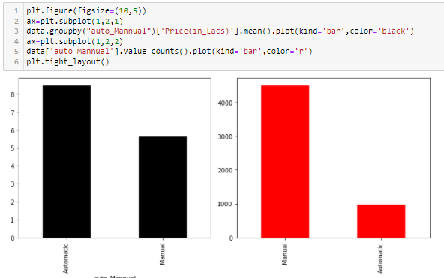
TYPE OF SELLS
As we can see the no. for manual car type are used more than the automatic but the price are high for automatic cars.

Slide 13
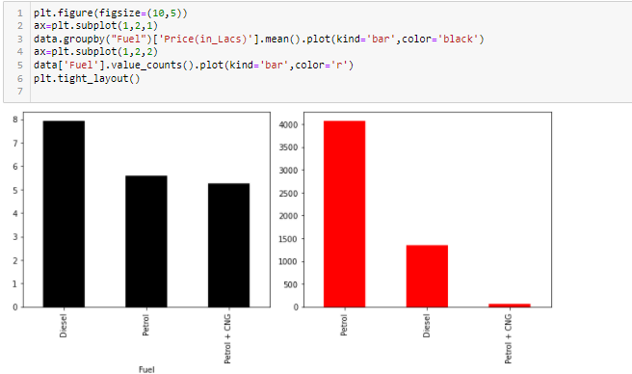
SHOWING SALES OF CARS WITH RESPECT TO FULE CONTAINER OF CARS
Here we analysed that there were more petrol car sale but the average sale for Diesel cars are higher than Petrol cars.

Slide 14
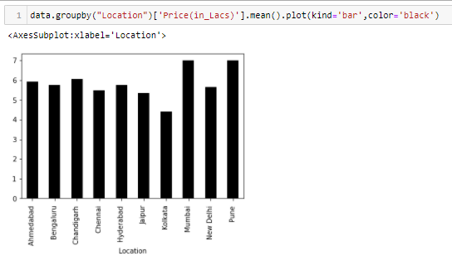
SHOWING AVRAGE SALE OF CARS AND WITH THIR LOCATION
Mumbai and Pune are having most expensive selling of cars.

Slide 15
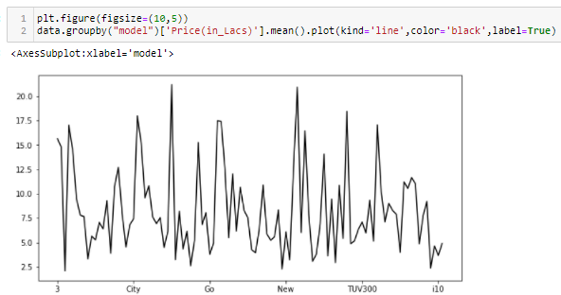
SHOWING AVERAGE PRICES OF CAR WITH RESPECT TO MODEL.
Benz type of model has highest Price.
A type of model has the lowest Price.

Slide 16
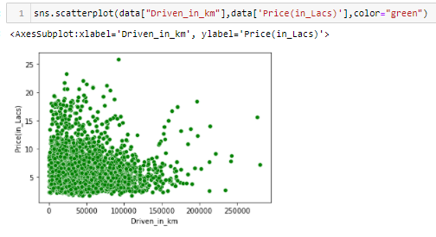
SHOWING PRICE V/S CAR DRIVEN.
There is slight relations between car driven and prices of cars that car is driven more prices are less.

Slide 17
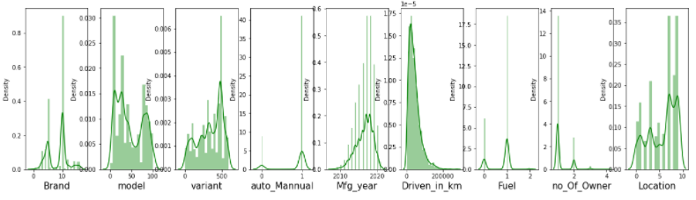
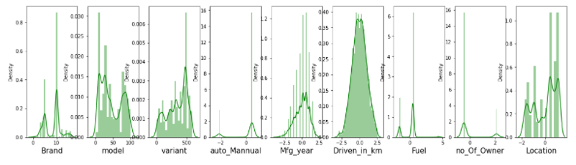
SHOWING DISTRIBUTION OF DATA
Before Cleaning :
After Cleaning :

Slide 18
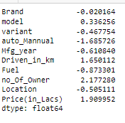
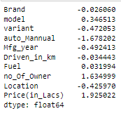
SHOWING SKEWNESS
Before Cleaning
After Cleaning

Slide 19
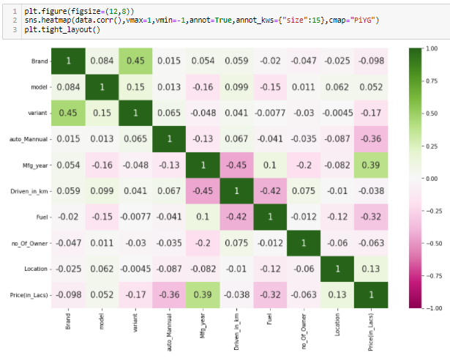
SHOWING RELATIONS OF FEATURES.

Slide 20
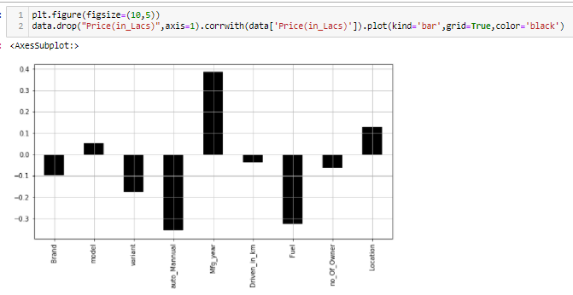
SHOWING FEATURES RELATIONS TO THE LABEL.

Slide 21
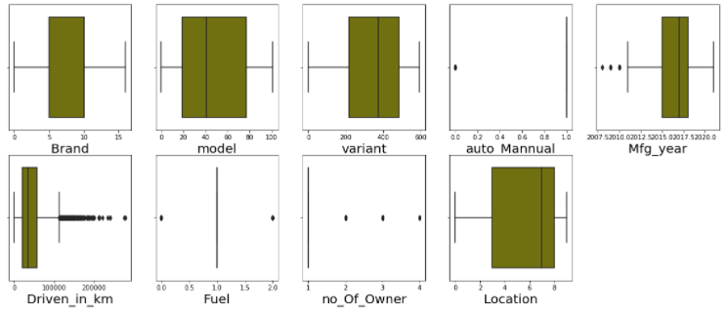
OUTLIERS DETECTIONS
In Column Auto_Manual boxplot shows outliers but this may be because of less no. of records for automatic cars.
Similarly in columns Mfg_year, Fuel, no. of Owner.

Slide 22
CONDITIONS THAT ARE CONSIDERED FOR DATA CLEANING & TRANSFORMED ACTIVITIES
Remove such records for Brand, no. of Owner, Fuel containing whose sub-category has less info.
Removed Outliers from Car driven as in the statistical description we have seen that max values was not acceptable.
Used Power Transformer with yeo-johnson method to reduce skewness.

Slide 23
MODEL DEPLOYMENT

Slide 24
ALGORITHM USED :
Used 5 models that are:
Linear Regression
Decision Tree
Random Forest
AdaBoost
Bagging
Support Vector Machine

Slide 25
BEFORE TRAINING OR TEST THE DATASET STEPS WE PERFORM
Used Power Transformer with yeo-johnson method to remove skewness
Standardized the data using StandardScalar().

Slide 26
ACCURACY OF EACH MODEL
The highest accuracy is 742.4% of model Logistic Regression at random state 176.
The highest accuracy is 91.6% of model Decision Tree at random state 176.
The highest accuracy is 94.17% of model Random Forest at random state 176.
The highest accuracy is 54.89% of model AdaBoost at random state 166.
The highest accuracy is 92.79% of model Bagging at random state 176.
The highest accuracy is 57.33% of the model SVM at random state 176.

Slide 27
BEST CV SCORE OF EACH MODEL
Mean CV Score of model Logistic Regression:: 33.25 at k-fold::3
Mean CV Score of model Decision Tree :: 82.24 at k-fold::5
Mean CV Score of model Random Forest :: 88.89 at k-fold::5
Mean CV Score of model AdaBoost :: 41.7 4at k-fold::3
Mean CV Score of model Bagging :: 87.75 at k-fold::5
Mean CV Score of model SVM :: 51.0 at k-fold::5

Slide 28
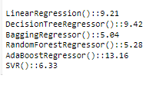
FINALIZED MODEL SELECTION
Least Difference between CV Score and R2 score of each model
Here for model RandomForestRegressor we get the least value i.e. the difference between the accuracy and cv Score of this model is 5.28 .

Slide 29
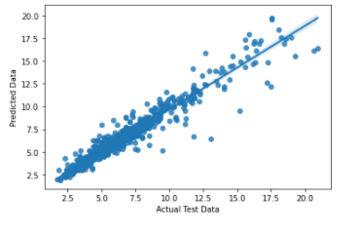
PLOT REGRESSION PLOT BETWEEN ACTUAL DATA AND PREDICTED VALUES
Here Data points are close to best fit line means residual is less.

Slide 30
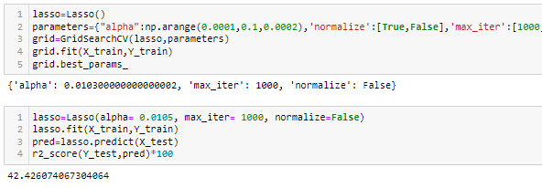
REGULARIZATION
Here we can see that our model is not overfitted or underfitted as the r2 score Lasso model is 42.42 while the random forest r2-score is 94.17.

Slide 31
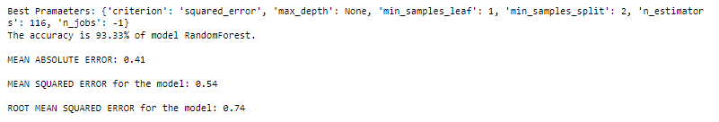
HYPER PARAMETER TUNING
Showing best parameters and accuracy, Confusion Matrix and Classification Report after Hyper tuning the Model.

Slide 32
THANK YOU!!

